Slide 1

Literature Review on FEDEX: An Explainability Framework for Data Exploration Steps
Shriya Prasanna
Girish Rajani
Subramanya ganesh

Slide 2
Issues in Exploratory Data Analysis (EDA)
Time Consuming
Have to analyze large number of rows
Formulate meaningful insights from the resulting dataframe
Mundane work of visualizing each and every resulting dataframe

Slide 3
What is FEDEX?
Fedex is an explainability framework that helps during EDA
Helps us understand and analyze the results of the dataframe after performing a query
Identifies interesting patterns
Determines which sets of rows are interesting
Automatically creates visualizations and textual explanations

Slide 4
Why Fedex?
Other similar frameworks such as SeeDB and Rath can only:
generate visualizations
Recommend next exploratory step
Provide insight recommendations
Fedex is the first system to automatically generate explanations along with visualizations w.r.t each query

Slide 5
How Fedex Works
Fedex employs a concept of interestingness and contribution in order to come up with the most appropriate explanation candidate
Pays more attention to sets of rows that are semantically related to reduce computation time
Interestingness is defined by using exceptionality for queries such as Filter, Join, Union, and diversity for Group-By queries by default
Contribution of sets of rows to the interestingness of a column A:
If the interestingness of a column A decreases after removing set of rows R and if the decrease is significant, R has a high contribution to the interestingness score

Slide 6
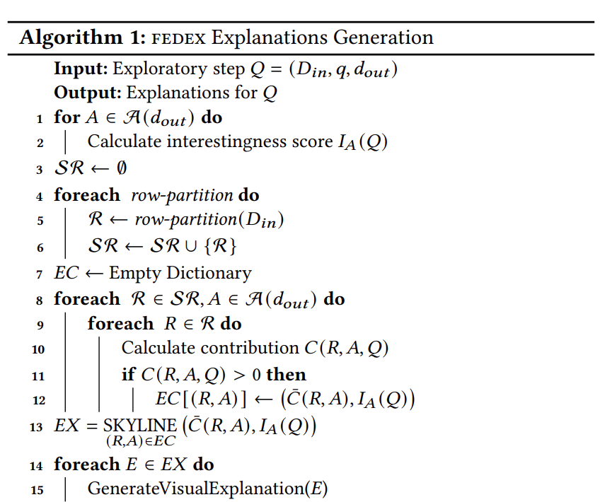
How Fedex Works Cont’d

Slide 7
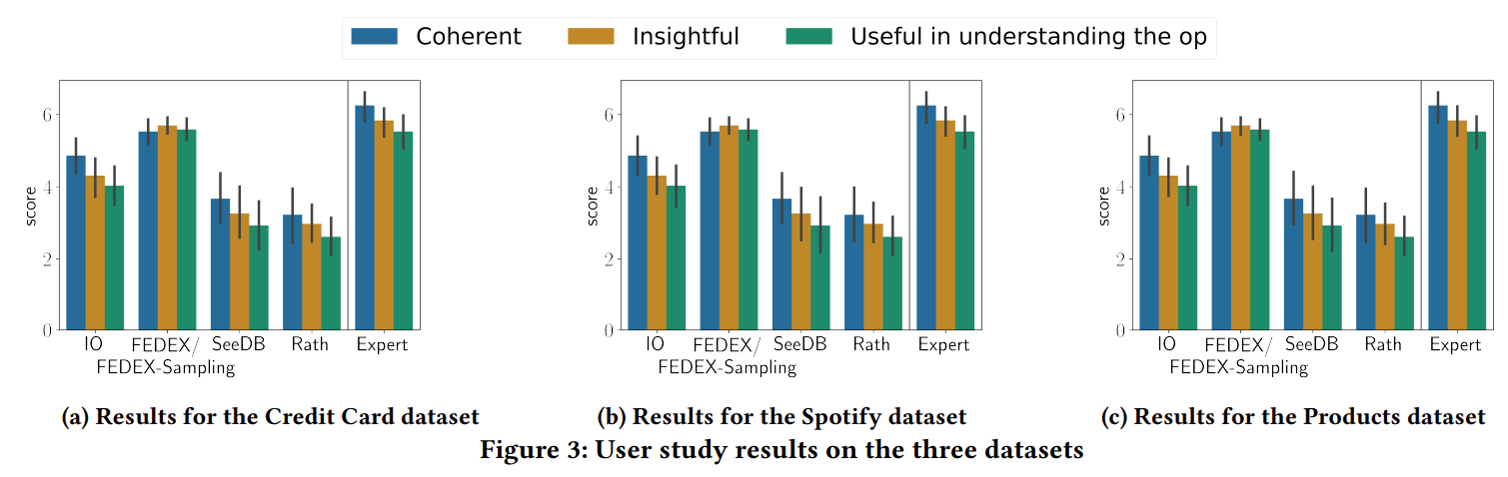
Comparison of Fedex vs Baselines

Slide 8
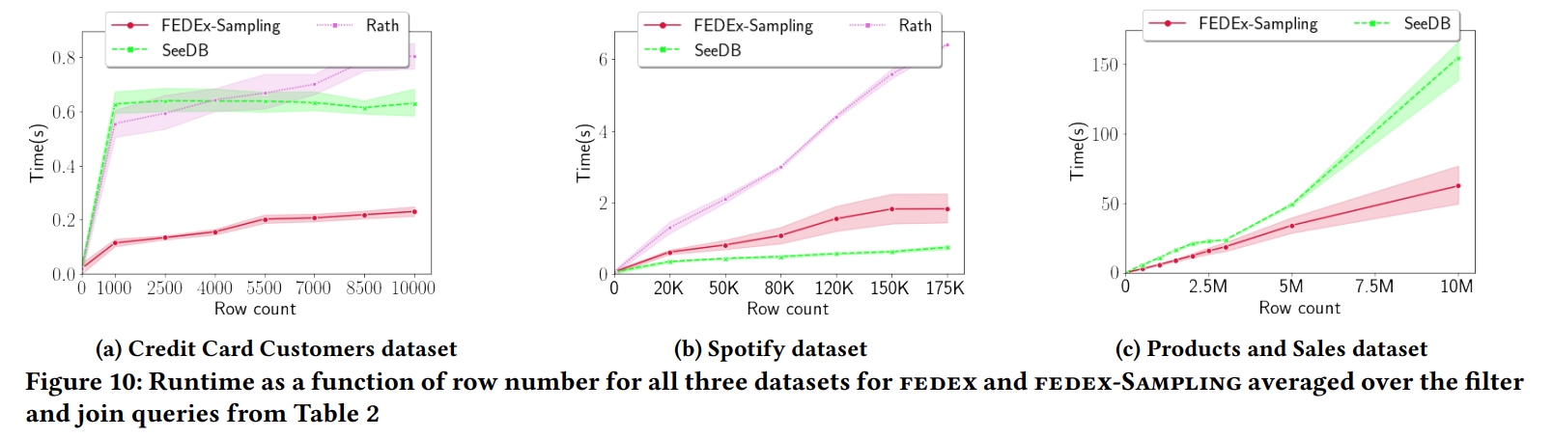
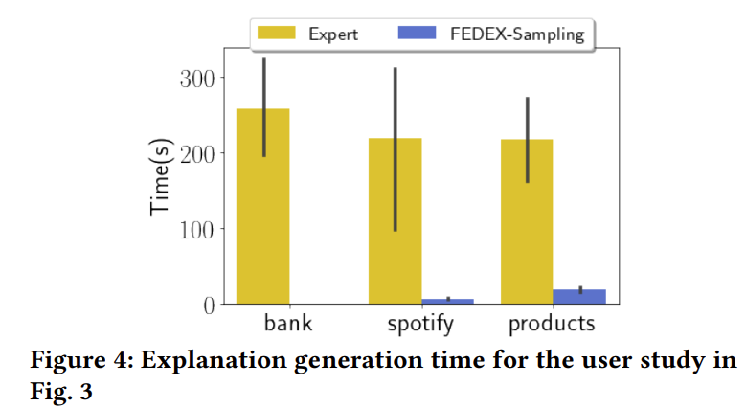
Runtime of Fedex vs Baselines

Slide 9
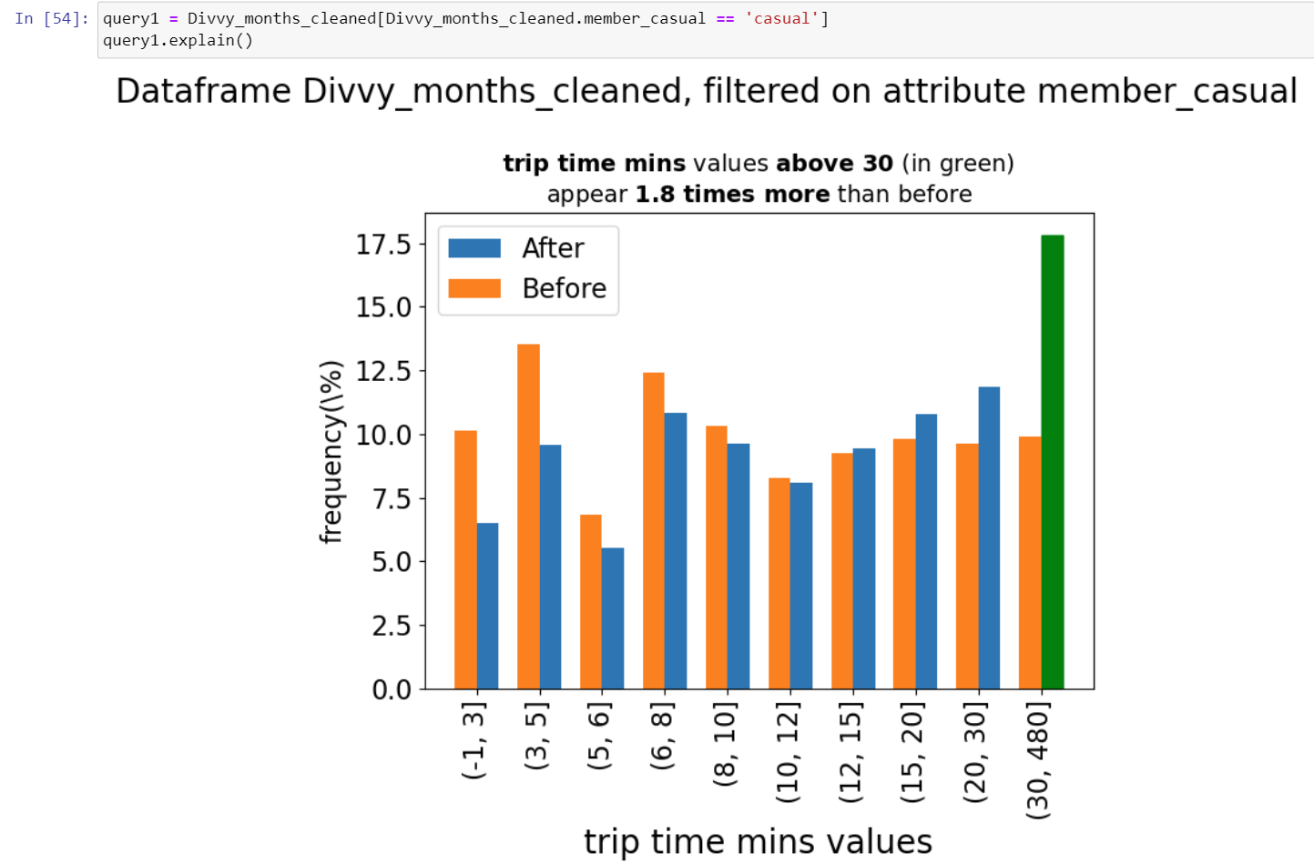
Implementing Fedex on Divvy Project
SELECT * FROM divvy_months_cleaned WHERE member_casual = ‘casual’;

